Slide 1

BeeHome
A software application designed for bed and breakfast
Course Name: Advance Topic for Application Development (DevOps)
Course ID: CSE461 Semester: Summer 2023 Section: 01
・Adnan Akanda 1821541 ・Maruf Hasan 1821933 ・Azwad Fawad Hasan 2020222

Slide 2
Content
Product Description
Key Technical Features of BeeHome
Choice of language and framework
Use of Version control, branching model
Different environments to deploy the system
CI/CD Pipeline for different environments
Unit test approach
Choice of Cloud Service for deployment
Choice of computation service
Details of additional cloud services
Deployment Architecture on the Cloud

Slide 3
Product Description
Key Technical Features of BeeHome

Slide 4
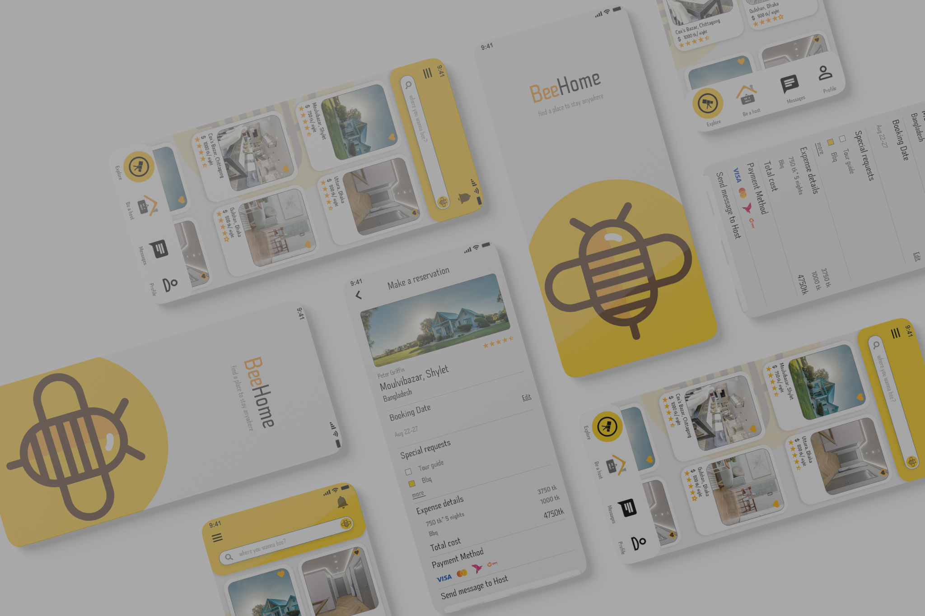

Product Description
BeeHome is a software application designed specifically for owners of small bed and breakfast establishments. As private family residences with an average of four to nine rooms, with six being the norm, these establishments provide overnight accommodation as well as breakfast for their guests.Typically, the hosts of a BeeHome also live in the home, making it a more intimate and personal experience for guests.

Slide 5
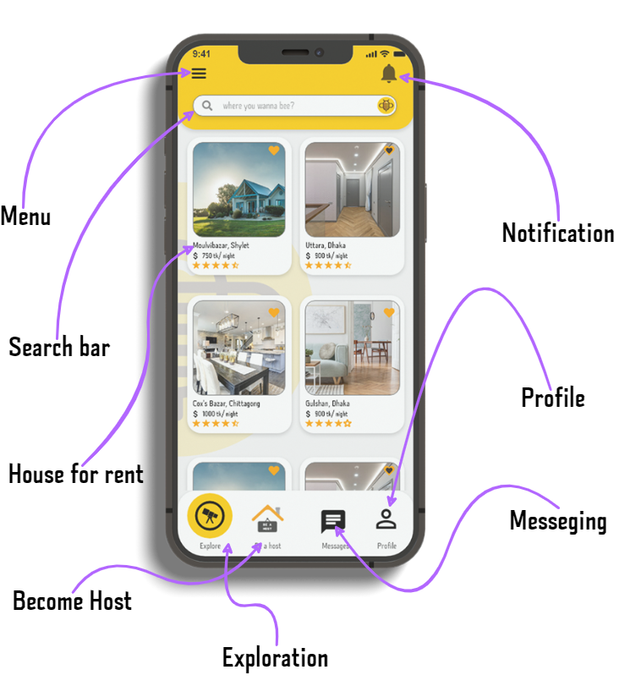
Key Technical Features
Mobile app and web-based application.
Cross-platform compatibility with any device with an internet connection.
User-friendly interface for small bed and breakfast establishments.
Guest & host information management.

Slide 6
Choice of language and framework
Use of Version control, branching model

Slide 7
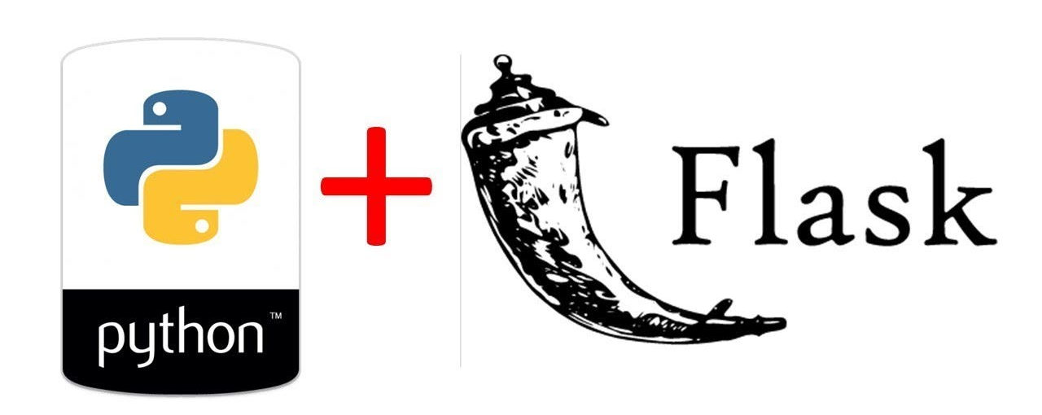

Choice of language and framework
Our recommendation for developing the BeeHome software application is to use Python as the programming language, Flask as the web framework and Flutter for app development.
For web application
For mobile application

Slide 8
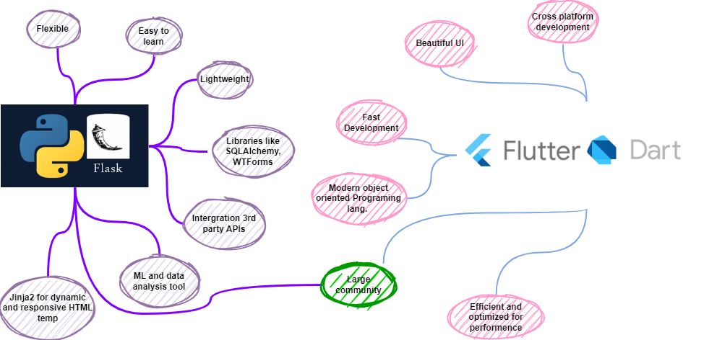

Slide 9
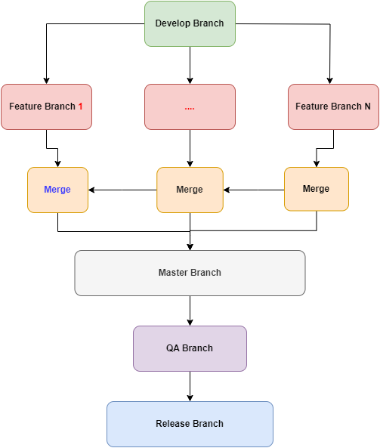
Use of Version control & branching model
Git and the GitFlow branching model are the version control systems that we advise using for the development of the BeeHome software application.
Widely Supported and Used
Git provides simple branching and merging
Speed and efficiency
Scalability

Slide 10
Different environments to deploy the system
CI/CD Pipeline for different environments

Slide 11
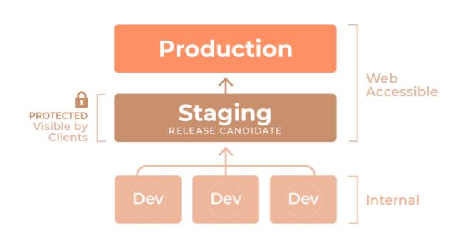
Different Environments

Slide 12
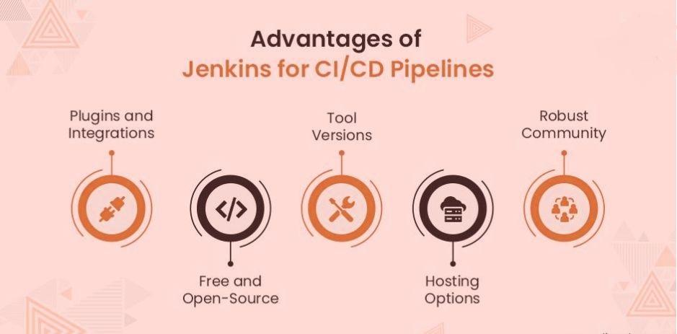
CI/CD using Jenkins

Slide 13
Unit Test
Choice Of Cloud Service For Deployment

Slide 14
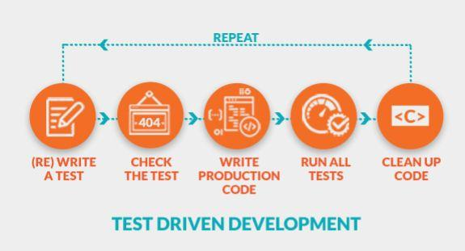
Unit Test

Slide 15
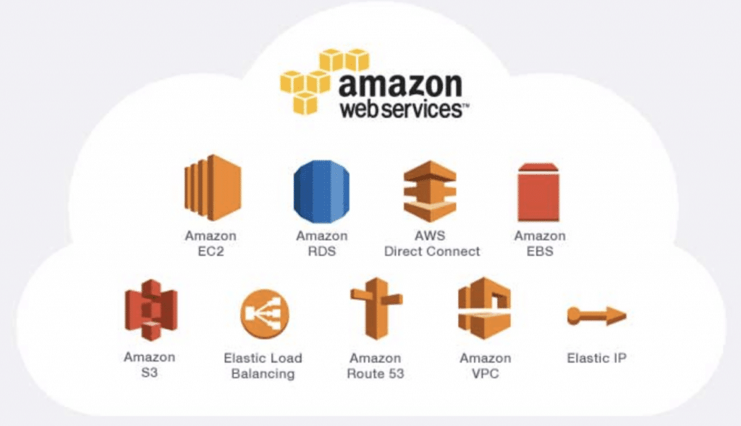
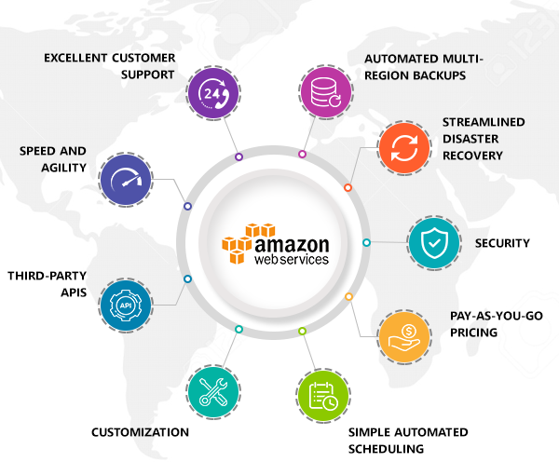
Choice Of Cloud Service

Slide 16
Choice of computation service
Details of additional cloud services
Deployment Architecture on the Cloud

Slide 17
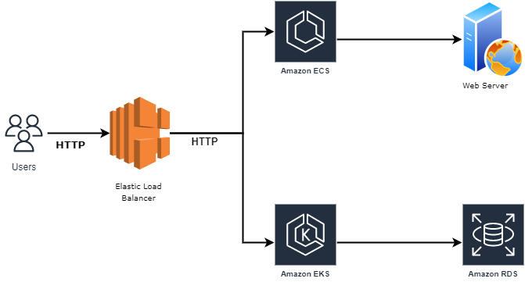
Choice of Computation Service

Slide 18
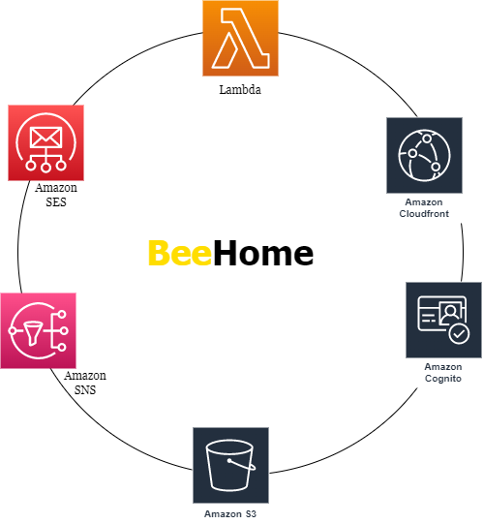
Additional Cloud Services
Amazon SES
Amazon SNS
AWS Lambda
Amazon Cloudfront
Amazon Cognito
Amazon S3

Slide 19
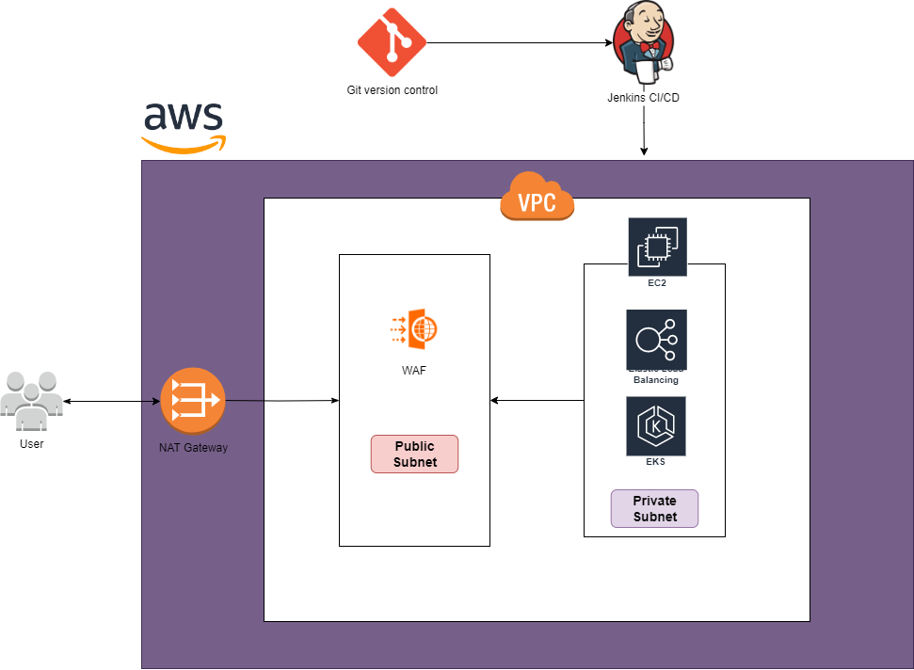
Deployment Architecture On Cloud

Slide 20
Thank You
Q/A Session

